Slide 1
Health Proxie
Android app based solution to search hospital using Geo-fence.

Slide 2
Background of the problem and Need/Goal of this app
Health was always been a dilapidated sector because of no health policy present.
New National Health Policy aims to achieve Universal Health Coverage with a bigger share of E-Health.
This is app-based solution for searching and finding hospitals near your location.
Our solution goal is to Inform, Clarify, Strengthen, Prioritize the role of government in shaping Health sector.

Slide 3
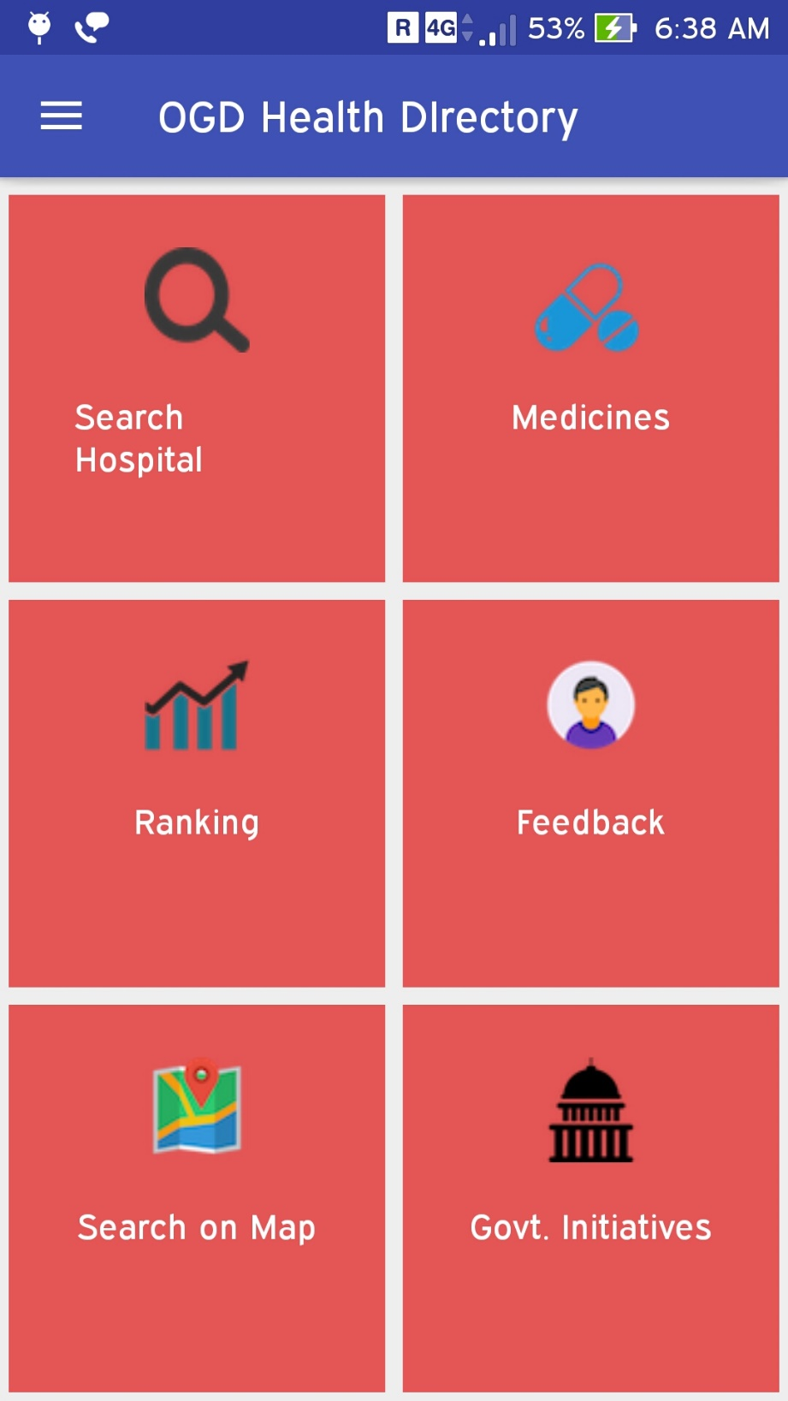
Brief Description
This app has mainly 6 components:
1. Search Hospital
2. Medicines
3. Ranking
4. Suggestions/Complaints
5. Find on the Map
6. Government initiatives

Slide 4
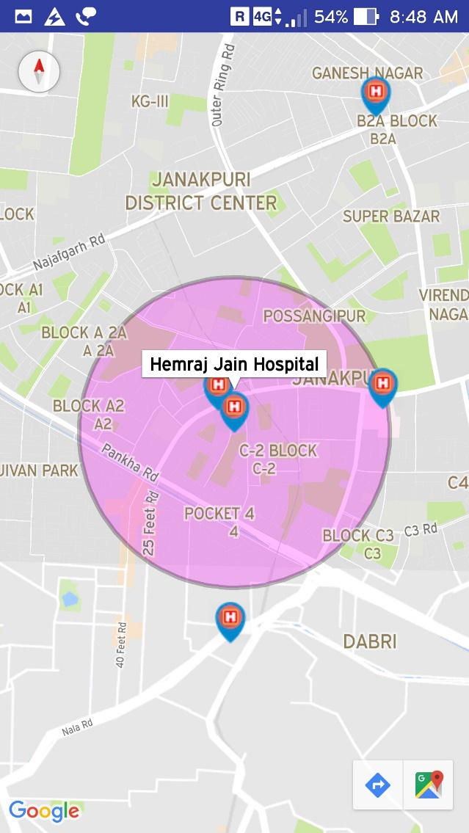
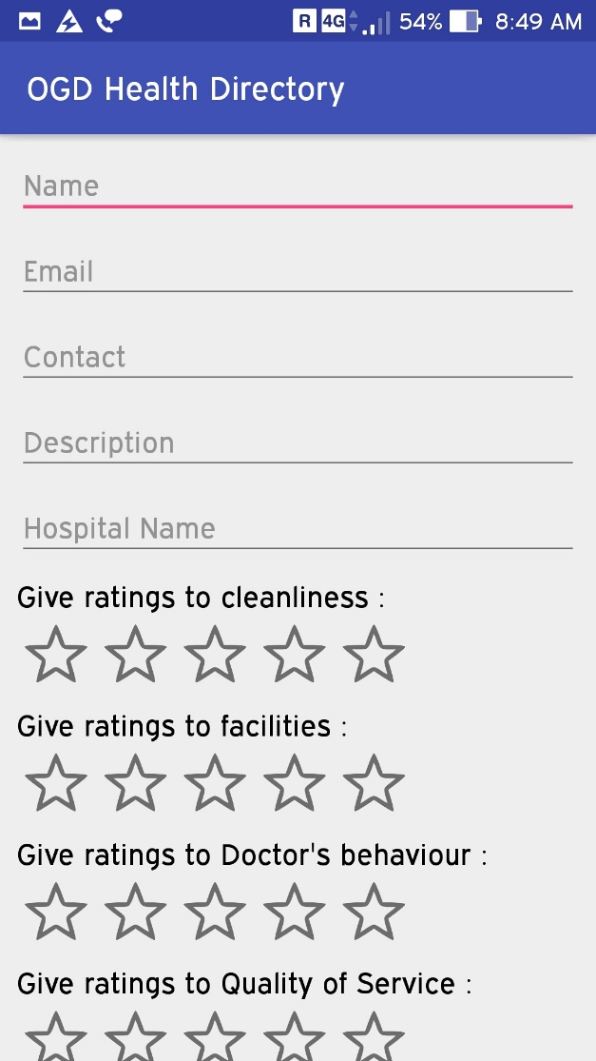
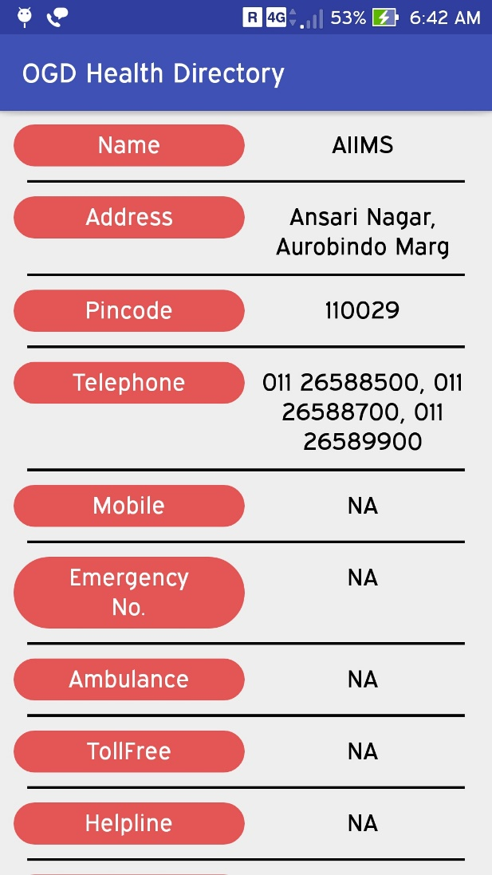
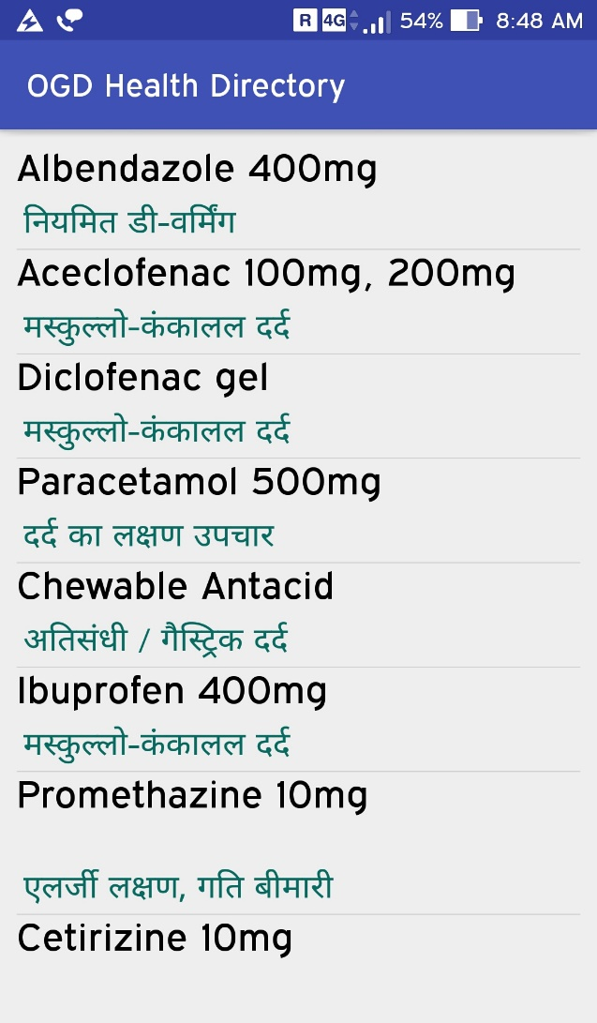
Demo of our android application

Slide 5
Future Upgradations
New parameters can be added for reviewing hospitals.
As the Health ministry and NITI Aayog proposed a framework to let private hospitals run selected services within district hospitals. If the dataset will be made available, we can provide info regarding those services too.
Maintain a Electronic Health Record (EHR) of registered users.

Slide 6
Thank You.

